Slide 1
Chapter 25: Spatial Data

Slide 2
Spatial and Geographic Databases
Spatial databases store information related to spatial locations, and support efficient storage, indexing and querying of spatial data.
Special purpose index structures are important for accessing spatial data, and for processing spatial join queries.
Computer Aided Design (CAD) databases store design information about how objects are constructed E.g.: designs of buildings, aircraft, layouts of integrated-circuits
Geographic databases store geographic information (e.g., maps): often called geographic information systems or GIS.

Slide 3
Representation of Geometric Information
Various geometric constructs can be represented in a database in a normalized fashion.
Represent a line segment by the coordinates of its endpoints.
Approximate a curve by partitioning it into a sequence of segments
  Create a list of vertices in order, or
  Represent each segment as a separate tuple that also carries with it the identifier of the curve
Closed polygons
  List of vertices in order, starting vertex is the same as the ending vertex, or
  Represent boundary edges as separate tuples, with each containing identifier of the polygon, or
  Use triangulation — divide polygon into triangles
    Note the polygon identifier with each of its triangles.

Slide 4
Representation of Geometric Constructs

Slide 5
Design Databases
Represent design components as objects (generally geometric objects); the connections between the objects indicate how the design is structured.
Simple two-dimensional objects: points, lines, triangles, rectangles, polygons.
Complex two-dimensional objects: formed from simple objects via union, intersection, and difference operations.
Design databases also store non-spatial information about objects (e.g., construction material, color, etc.)
Spatial integrity constraints are important.
eg. Pipes should not intersect, wires should not be too close to each other, etc.
  E.g., pipe wires

Slide 6
Geographic Data
Raster data consist of bit maps or pixel maps, in two or more dimensions.
  Example 2-D raster image: satellite image of cloud cover, where each pixel stores the cloud visibility in a particular area.
  Additional dimensions might include the temperature at different altitudes (海拔) at different regions, or measurements taken at different points in time.
Design databases generally do not store raster data.

Slide 7
Geographic Data (Cont.)
Vector data are constructed from basic geometric objects: points, line segments, triangles, and other polygons in two dimensions, and cylinders, spheres, cuboids (長方體), and other polyhedrons (多角體) in three dimensions.
Vector format often used to represent map data.
  Roads can be considered as two-dimensional and represented by lines and curves.
  Some features, such as rivers, may be represented either as complex curves or as complex polygons, depending on whether their width is relevant.
  Features such as regions and lakes can be depicted as polygons.

Slide 8
Applications of Geographic Data
Examples of geographic data
  map data for vehicle navigation
  distribution network information for power, telephones, water supply, and sewage (下水道)
Vehicle navigation systems store information about roads and services for the use of drivers:
  Spatial data: e.g., road/restaurant/gas-station coordinates
  Non-spatial data: e.g., one-way streets, speed limits, traffic congestion
Global Positioning System (GPS): utilizes information broadcast from GPS satellites to find the current location of user with an accuracy of tens of meters.
  increasingly used in vehicle navigation systems

Slide 9
Spatial Queries
Nearness queries request objects that lie near a specified location.
Nearest neighbor queries, given a point or an object, find the nearest object that satisfies given conditions.
Region queries deal with spatial regions. e.g., ask for objects that lie partially or fully inside a specified region.
Queries that compute intersections or unions of regions.
Spatial join of two spatial relations with the location playing the role of join attribute.

Slide 10
Spatial Queries (Cont.)
Spatial data is typically queried using a graphical query language; results are also displayed in a graphical manner.
Graphical interface constitutes the front-end
Extensions of SQL with abstract data types, such as lines, polygons and bit maps, have been proposed to interface with back-end.
  allows relational databases to store and retrieve spatial information
  Queries can use spatial conditions (e.g., contains or overlaps).
  queries can mix spatial and nonspatial conditions

Slide 11
Indexing of Spatial Data
k-d tree - early structure used for indexing in multiple dimensions.
Each level of a k-d tree partitions the space into two.
  choose one dimension for partitioning at the root level of the tree.
  choose another dimensions for partitioning in nodes at the next level and so on, cycling through the dimensions.
In each node, approximately half of the points stored in the sub-tree fall on one side and half on the other.
Partitioning stops when a node has less than a given maximum number of points.

Slide 12
Division of Space by a k-d Tree
Each line in the figure (other than the outside box) corresponds to a node in the k-d tree.
  The maximum number of points in a leaf node has been set to 1.
The numbering of the lines in the figure indicates the level of the tree at which the corresponding node appears.

Slide 13
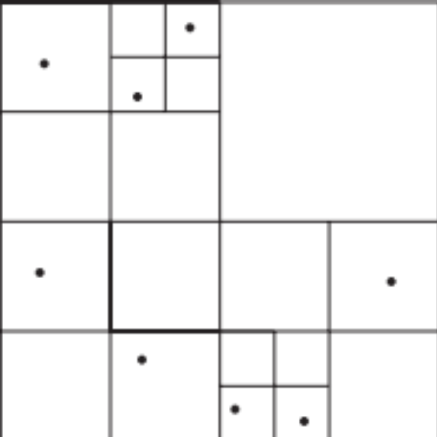
Division of Space by Quadtrees
Quadtrees
Each node of a quadtree is associated with a rectangular region of space; the top node is associated with the entire target space.
Each non-leaf nodes divides its region into four equal sized quadrants
  Correspondingly each such node has four child nodes corresponding to the four quadrants and so on
Leaf nodes have between zero and some fixed maximum number of points (set to 1 in example).

Slide 14
R-Trees
R-trees are a N-dimensional extension of B⁺-trees, useful for indexing sets of rectangles and other polygons.
Supported in many modern database systems, along with variants like R⁺ -trees and R*-trees.
Basic idea: generalize the notion of a one-dimensional interval associated with each B+ -tree node to an
N-dimensional interval, that is, an N-dimensional rectangle.
Will consider only the two-dimensional case (N = 2)
  generalization for N > 2 is straightforward, although R-trees work well only for relatively small N

Slide 15
R Trees (Cont.)
A rectangular bounding box is associated with each tree node.
  Bounding box of a leaf node is a minimum sized rectangle that contains all the rectangles/polygons associated with the leaf node.
  The bounding box associated with a non-leaf node contains the bounding box associated with all its children.
  Bounding box of a node serves as its key in its parent node (if any)
  Bounding boxes of children of a node are allowed to overlap
A polygon is stored only in one node, and the bounding box of the node must contain the polygon.

Slide 16
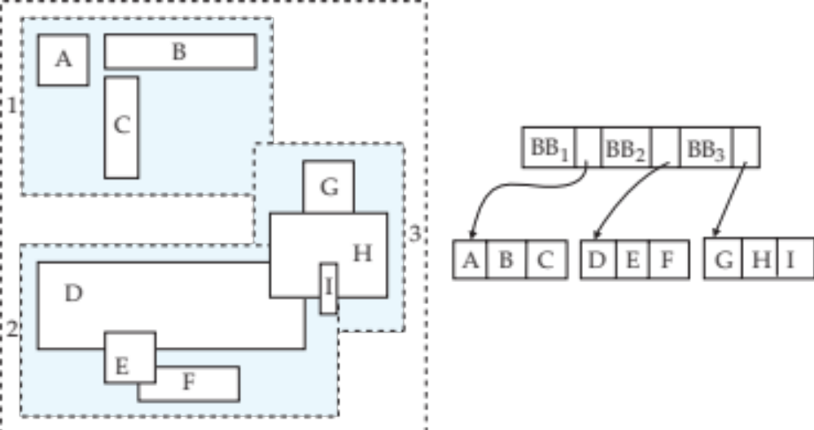
Example R-Tree
A set of rectangles (solid line) and the bounding boxes (dashed line) of the nodes of an R-tree for the rectangles. The R-tree is shown on the right.

Slide 17
Search in R-Trees
To find data items (rectangles/polygons) intersecting (overlaps) a given query point/region, do the following, starting from the root node:
  If the node is a leaf node, output the data items whose keys intersect the given query point/region.
  Else, for each child of the current node whose bounding box overlaps the query point/region, recursively search the child
Can be very inefficient in worst case since multiple paths may need to be searched
  but works acceptably in practice.
Simple extensions of search procedure to handle predicates contained-in and contains

Slide 18
Insertion in R-Trees
To insert a data item:
  Find a leaf to store it, and add it to the leaf
    To find leaf, follow a child (if any) whose bounding box contains bounding box of data item, else child whose overlap with data item bounding box is maximum
  Handle overflows by splits (as in B+-trees)
    Split procedure is different though (see below)
  Adjust bounding boxes starting from the leaf upwards
Split procedure:
  Goal: divide entries of an overfull node into two sets such that the bounding boxes have minimum total area
    This is a heuristic. Alternatives like minimum overlap are possible
  Finding the “best” split is expensive, use heuristics instead
    See next slide

Slide 19
Splitting an R-Tree Node
Quadratic split divides the entries in a node into two new nodes as follows
  Find pair of entries with “maximum separation”
    that is, the pair such that the bounding box of the two would has the maximum wasted space (area of bounding box – sum of areas of two entries)
  Place these entries in two new nodes
  Repeatedly find the entry with “maximum preference” for one of the two new nodes, and assign the entry to that node
    Preference of an entry to a node is the increase in area of bounding box if the entry is added to the other node
  Stop when half the entries have been added to one node
    Then assign remaining entries to the other node

Slide 20
Deleting in R-Trees
Deletion of an entry in an R-tree done much like a B⁺-tree deletion.
  In case of underfull node, borrow entries from a sibling if possible, else merging sibling nodes
  Alternative approach removes all entries from the underfull node, deletes the node, then reinserts all entries

Slide 21
RASTER : Bit representation
VECTOR : Object representation
    2 dimensi
    3 dimensi
    GIS : Koordinat bumi (lintang, bujur)

Slide 22
Tugas
Per mhs:
Mempelajari dan menjelaskan metode index untuk data spasial: R*-tree

